Slide 1
Wharton PLASTARC People Analytics Case Competition
Understanding Employee Workplace Preferences
Team - SFRR Analytics

Slide 2




Problem Statement: Shifting of Working Patterns
+500%
50%
1,384
?
WFH increased from 5% to 30% since 2019
Office occupancy at half of
pre-pandemic level
Gathered 1,384 surveys with 183 questions from 5 organizations
Productivity?
Preference?
How can an organization best support its employee?

Slide 3



Executive Summary
Employees have a wide range of preferences and very specific needs
Negative perception can drive down employee satisfaction
Need to understand employees and fine tune to support their work styles
Complication
Large no. of productive hours lost due to office layout and collaboration issues
Ability to collaborate effectively - key factor for determining work location
WFH Employees tend to be bit averse to cultural engagement – need to understand preferences & tailor engagement activities
Varying Problems
Introduce a Gen AI Workforce Copilot - empower employees with an assistant
Workplace design modifications to boost collaboration & focus
Fine-tune events to employee interests. Recognizing merit is key
Estimated 418 hours increase in productive hours per week.
Estimated Satisfaction Index improvement by almost 1.6 points
Recommendations

Slide 4





Objective: What are we trying to solve?
42% Feel More Productive at Home*
43% Feel More Productive at Office*
Recommendations and Deployment
Rule-Based Segmentation
Modeling for More Insights
Identifying Productivity and Preference Factors
Understand Employee’s Behavior
*Result of Forbes research through surveys. People are split about their preferences. https://www.forbes.com/sites/tracybrower/2023/08/06/the-productivity-problem-with-remote-work.

Slide 5
Analysis on Work Productivity and Preference

Slide 6



Ability to Collaborate Effectively is a key factor in determining Perceived Productivity
Perceived Collaborative Quotient
comprises abilities for:
Colleague Access
Manager Interaction
Client Engagement
High correlation between Perceived Productivity and Collaborative Quotients
*Average of Post Covid Impact Shift Metrics A & E; 0 = Home Preferred, 5 = Office Preferred
¹ Average of Post Covid Impact Shift Metrics F, I & J; 0 = Home Preferred, 5 = Office Preferred

Slide 7



Distractions may cause employees to stay at home to stay productive. Can lead to huge number of lost hours
(Pre-Covid) More Time Lost Due to Distractions
Layout Issues
280
274
Noise Disturbances
Time Loss Due to Distractions
(Minute/Week)
256
Visitor Disruption
210
189
Distractions (Pre-Covid) cause employees to stay home to be productive
Office goer might opt for home office option in the future to reduce distraction
WFH Preference Rate
0-20%
20-40%
40-60%
60-80%
80-100%
Productivity Quotient* | 3.6 | 3.2 | 1.9 | 1.8 | 0.6
More productive at home
*Average of Post Covid Impact Shift Metrics A & E; 0 = Home Preferred, 5 = Office Preferred

Slide 8




“Composite Work Location Preference” score highly correlated to WFH Preference Rate
-2.4
Ability to
Be Individually Productive
Ability to
Collab Effectively
Composite Work Location
Preference Score*
Strongly
Influence
0-20%
20-40%
40-60%
60-80%
80-100%
Location Employee Want to Work in
WFH Preference Rate
*Average of 11 Post Covid Impact Shift Metrics (A-K); 0 = Home Preferred, 5 = Office Preferred. Used as a Proxy to handle missing values in WFH Pref Rate Metric

Slide 9


Preferred Workplace based on Culture Quotient
Socially active employees prefer office work
WFH employees tend to be more averse to social events
Highly Correlated
Leadership positively influences Org Culture
Opportunity to involve remote workers in cultural initiatives
Unite employees with a sense of belongings
*Average of DECSN factors H, K, L & Q; 0 = Unimportant, 5 = Important
Notes:
Forbes acknowledges the challenge of enforcing office culture in a WFH (Work From Home) setting

Slide 10
Improving collaborative capabilities at the office can be crucial
Office goers are satisfied with the collaboration setup
Office Collab Satisfaction*
There are still room of improvement for office collaboration setup for WFH workers
0-20%
20-40%
40-60%
60-80%
80-100%
WFH Preference Rate
*Average of SATSF Facilitate Office (2B & 2C) & OfficeTech (4B) ; 0 = Unsatisfied, 5 = Satisfied

Slide 11




Ability to spend uninterrupted focused hours drives work location preferences
Employees who love to do focused work at home
0.8
Employees who love to switch from focused work to collaborative work/social events intermittently
WFH Preference Rate
0.6
0.4
0.2
Employees who love to do focused work at office with privacy
0.0
Home
Temporary Workspace
Office Workstation
Enclosed Office Space
Preferred Environment
for Focus Work

Slide 12
Modeling

Slide 13


Collaborative Space Preferences & Productivity Loss – Key factors for determining workplace preference
Key Factors – Derived from Shapley Analysis of Predictive Modeling Outcomes
Preprocess Data For Modeling
Factor Name | Factor Alignment / Description | Shapley Values
Factor 9 – Workspace for Focus & Collab | Preferred workspace and location for in-person collaboration and tasks that require undivided attention | 0.36
Factor 3 – Workplace Features Preference | Importance of workplace and work environment features | 0.35
Factor 1 - Collaboration Satisfaction | Employee satisfaction levels with respect to collaboration in the workplace | 0.22
Factor 10 – Productivity Hindrances | Major workplace issues that contributed to loss of productive hours | 0.20
Remove Columns with >80% Nulls
Decompose
with Factor
Analysis
Data to information
Decision Tree Model
Shapley Analysis
+
Analyze Factor
Loadings
Note: “Compositive Work Location Preference Score” is used as Target Variable for Decision Tree Model Calculated as an Average of 11 Post Covid Impact Shift Metrics (A-K); 0 = Home Preferred, 5 = Office Preferred

Slide 14
Segmentation

Slide 15


Segmenting Employees can help us understand their specific needs
Productivity and Preference of Work Location
Home Anchors
64% Customer Support
62% Sales, Mktg, HR, Mgmt
46% Tech
Hybrid Force
50% Construction & Architecture
38% Environmental & Transport
Office Cohort
42% Environmental & Transport
27% Architecture & Construction

Slide 16




Segmentation – Cluster 1 (WFH Employees)
Productivity and Preference of Work Location
Home Anchors
64% Customer Support
62% Sales, Mktg, HR, Mgmt
46% Tech
Hybrid Force
50% Construction & Architecture
38% Environmental & Transport
Office Cohort
42% Environmental & Transport
27% Architecture & Construction
105 min/week
4.0
2.6
0.5
Noise Distraction
Low Noise Focus
On a scale 0 – 5
(5 – most importance)
Ability to focus (3.6)
Noise level (4.0)
Collab
On a scale 0 – 5
(0 – better at home, 5 – better at office)
Hanging on the edge about where to access others
Culture
On a scale 0 – 5
(5 – most importance)
Not satisfied nor interested in organizational culture

Slide 17



Segmentation – Cluster 2 (Hybrid Employees)
Productivity and Preference of Work Location
Home Anchors
64% Customer Support
62% Sales, Mktg, HR, Mgmt
46% Tech
Hybrid Force
50% Construction & Architecture
38% Environmental & Transport
Office Cohort
42% Environmental & Transport
27% Architecture & Construction
137 min/week
2.7
3.1
2.2
Visitor Disruption
Productivity
On a scale 0 – 5
(0 – better at home, 5 – better at office)
Feel slightly more productive at office
Collab
On a scale 0 – 5
(0 – better at home, 5 – better at office)
They need some collab accessibility at office
In-person Collab
On a scale 0 – 5
(5 – most satisfied)
Home (2.2)
Office (4.0)

Slide 18



Segmentation – Cluster 3 (Work from Office Employees)
Productivity and Preference of Work Location
Home Anchors
64% Customer Support
62% Sales, Mktg, HR, Mgmt
46% Tech
Hybrid Force
50% Construction & Architecture
38% Environmental & Transport
Office Cohort
42% Environmental & Transport
27% Architecture & Construction
53 min/week
3.9
3.6
3.8
Layout Distraction
Proximity
On a scale 0 – 5
(5 – most importance)
Proximity to coworkers is very important to them
Collab
On a scale 0 – 5
(0 – better at home, 5 – better at office)
Feel that it’s easy to access others at office
Office Design
On a scale 0 – 5
(5 – most satisfied)
There’s still room of improvement on office design

Slide 19
RECOMMENDATIONS

Slide 20



Recommended Actions – Targeted action can resolve the key issues for each group
Personal Office Assistant
Facilitates Easy Navigation In Office
Fosters Channelized Collaboration
O
Noise Canceling Headphones
Cubicles/Focus Rooms
Strategic Workplace Design
Merit Spotlight Program
Learning Club Initiatives
Periodic Employee Pulse
WORKFORCE COPILOT
FOCUS DRIVERS
CULTURE CODE ENHANCEMENT

Slide 21

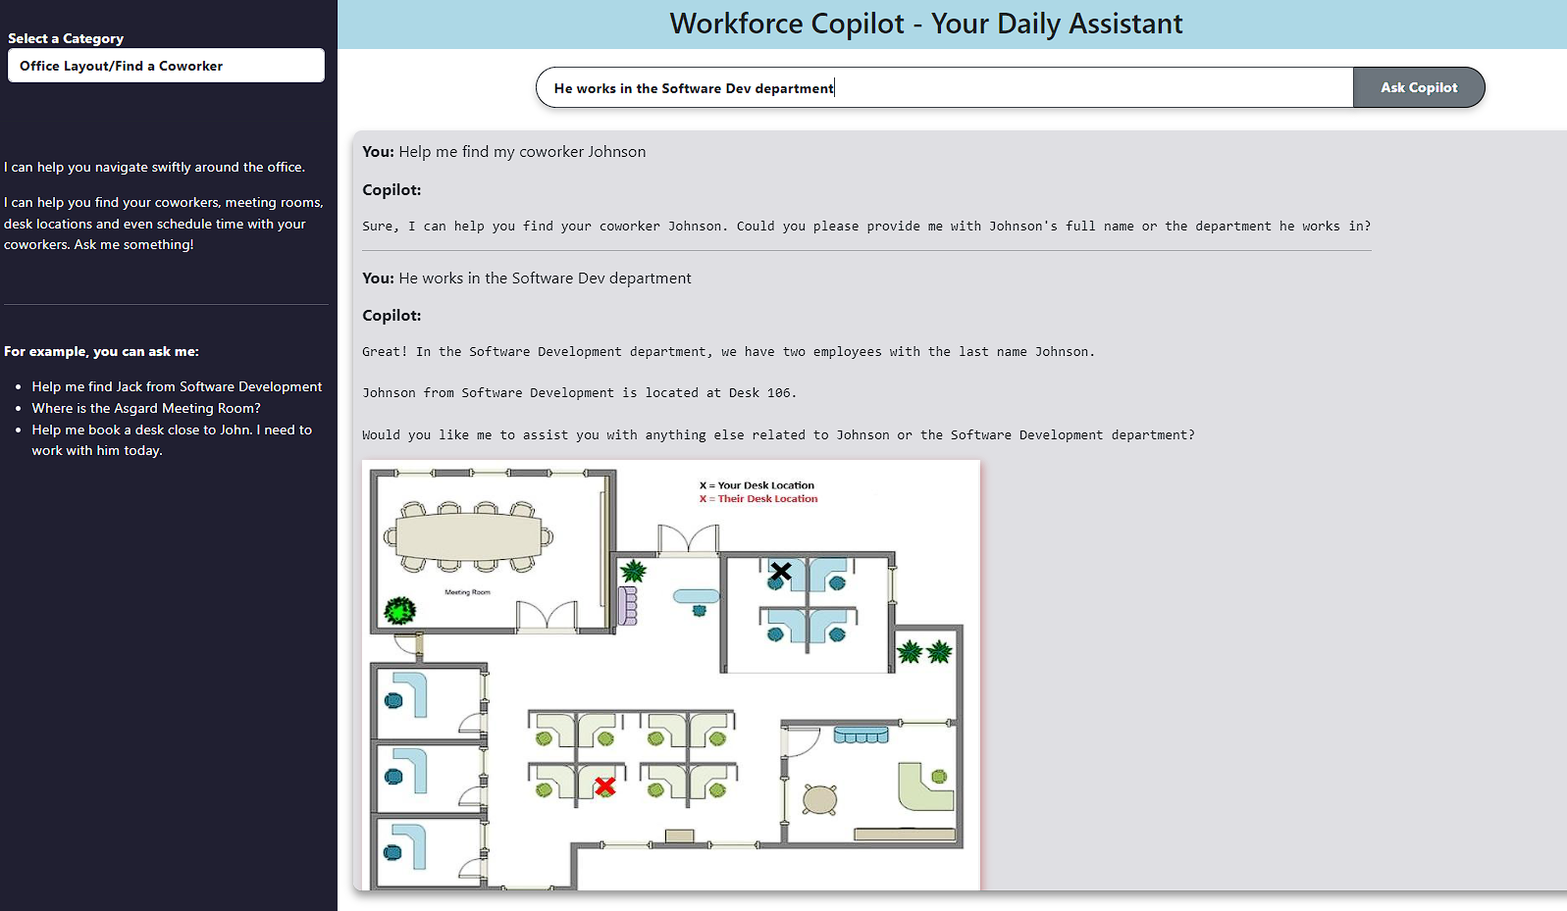




Introducing R.O.B – Employees’ Resourceful Office Buddy for everyday assistance
Employee
Has queries about the workplace
Helps find where people are located
Ask the Workplace Copilot Assistant
Assists in Performing Tasks & Provides Insights
Redirects to Tech/Customer Support If Requested
Video demonstration available in the Appendix Section

Slide 22
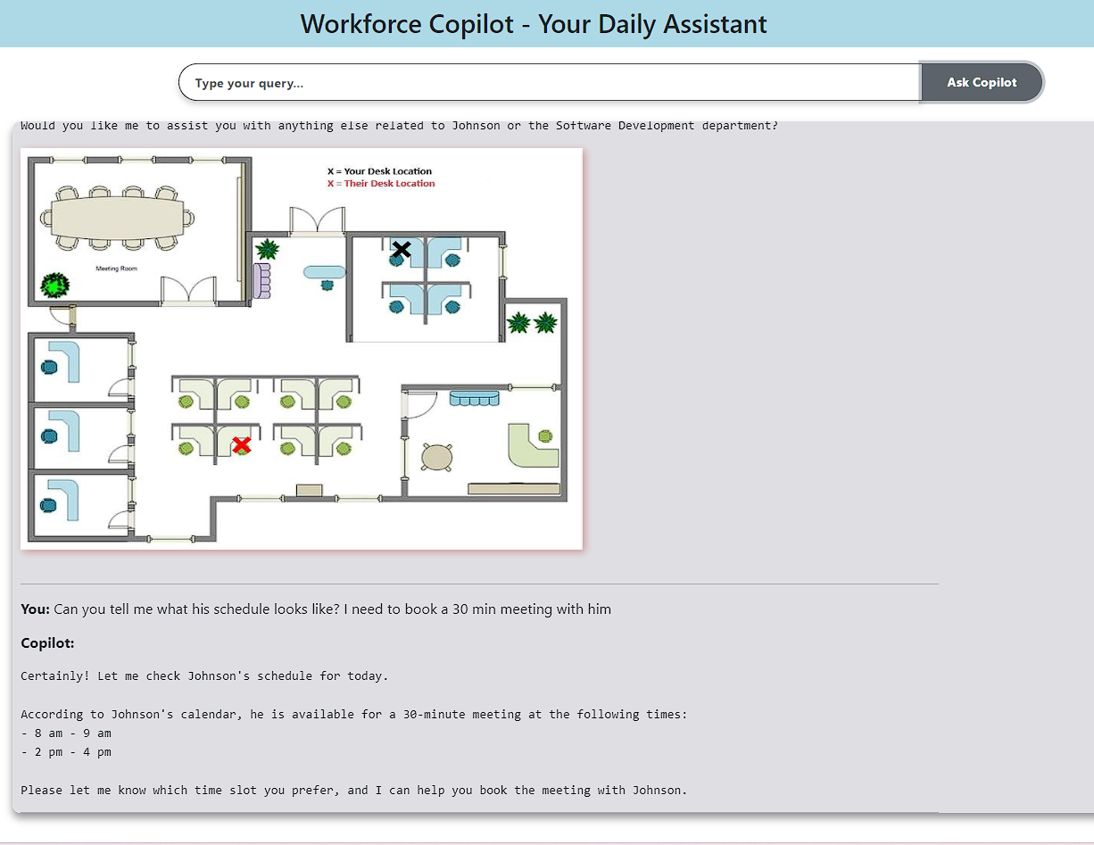
Introducing R.O.B – Employees’ Resourceful Office Buddy for everyday assistance
Employee
Has queries about the workplace
Ask the Workplace Copilot Assistant
Fosters easy collaboration with coworkers by being respectful of their schedules
Assists in Performing Tasks & Provides Insights
Redirects to Tech/Customer Support If Requested
Video demonstration available in the Appendix Section

Slide 23
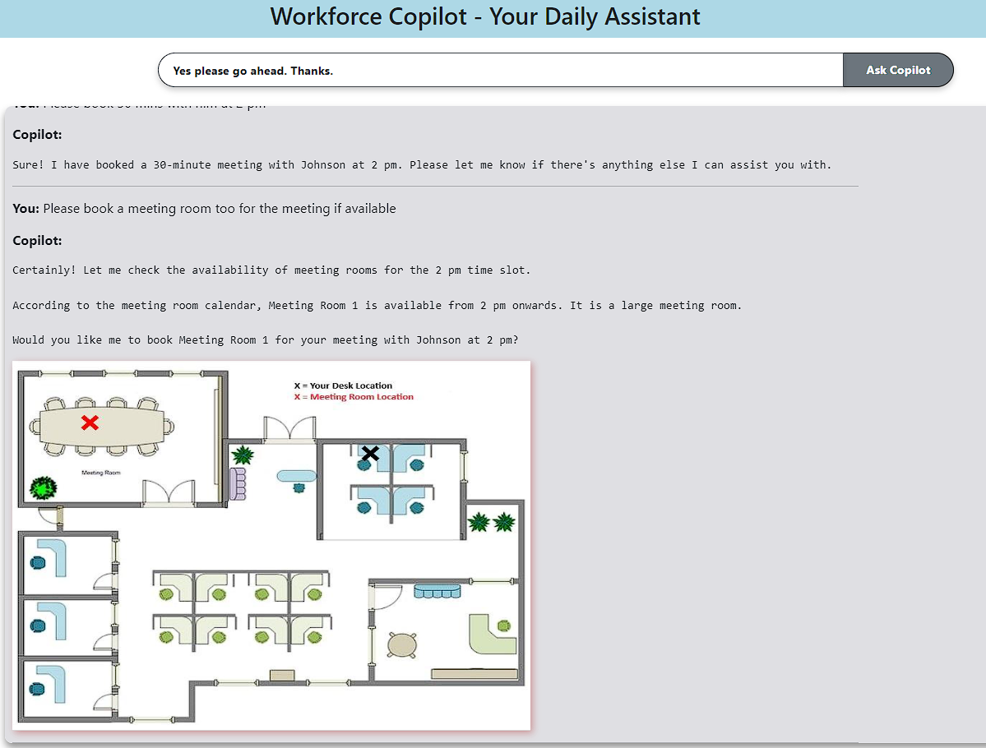
Introducing R.O.B – Employees’ Resourceful Office Buddy for everyday assistance
Employee
Has queries about the workplace
Ask the Workplace Copilot Assistant
Assists in Performing Tasks & Provides Insights
Provides office map of where meetings are setup to ensure easy navigation
Redirects to Tech/Customer Support If Requested
Video demonstration available in the Appendix Section

Slide 24



Tailored recommendations can potentially save productive hours and boost employee satisfaction
~84%
33.48
1.5 Pts
Office Cohort (Time Lost – Layout)
Employees In This Group Facing Issue
Productive Hrs Increased
Potential Increase in Satisfaction
~78%
192.07
1.4 Pts
1.6 Pts
Overall Increase in Potential Satisfaction
Hybrid Force (Time Lost – Visitors)
Employees In This Group Facing Issue
Productive Hrs Increased
Potential Increase in Satisfaction
~76%
193
1.8 Pts
Home Anchors (Time Lost – Noise)
Employees In This Group Facing Issue
Productive Hrs Increased
Potential Increase in Satisfaction
~418 Hours
Overall Increase in Potential Productive Hrs Per Week
Assuming Implementation for a Medium Size Firm (500 Employee) | Assuming 60% Effectiveness of the proposed solutions | Satisfaction Scale: Very Unsatisfied (0) – (5) Very Satisfied

Slide 25
Estimated Immediate Impact vs Implementation Effort can be used to prioritize proposed solutions
Estimated Immediate Impact
Immediate Attention Noise Canceling Headphones Merit Spotlight Programs Learning Club Initiative | Medium Term Initiatives Workforce Copilot Cubicles/Focus Rooms
Major Projects Strategic Workplace Design | Long Term Strategies Periodic Employee Pulse & Feedback Improvement
Implementation Effort
Phase 1
Immediate Attention
Phase 2
Medium Term Initiatives
Phase 3
Major Projects
Phase 4
Long Term Strategies

Slide 26
Thank You! Questions?

Slide 27
APPENDIX

Slide 28
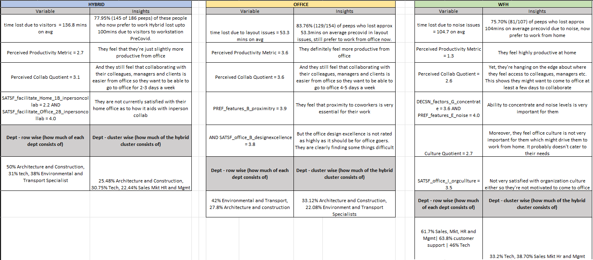
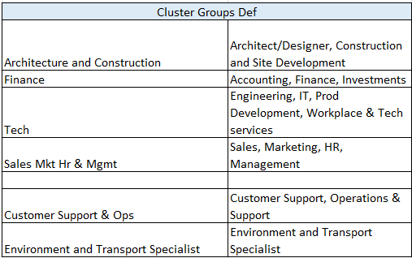
Cluster - Detailed

Slide 29
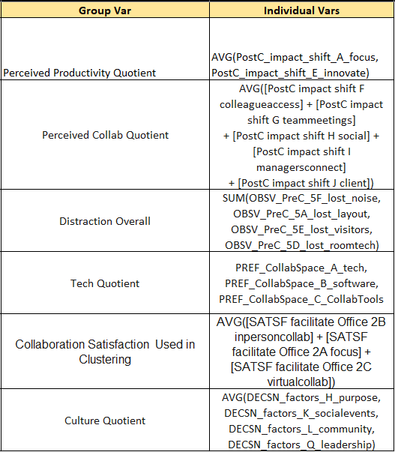
Important Variables

Slide 30
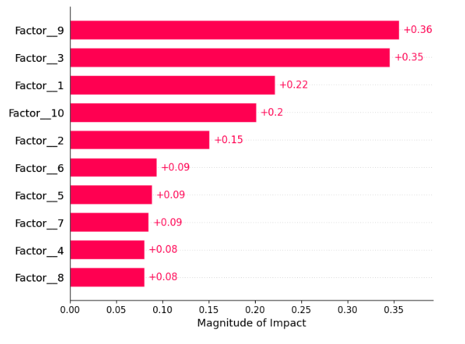
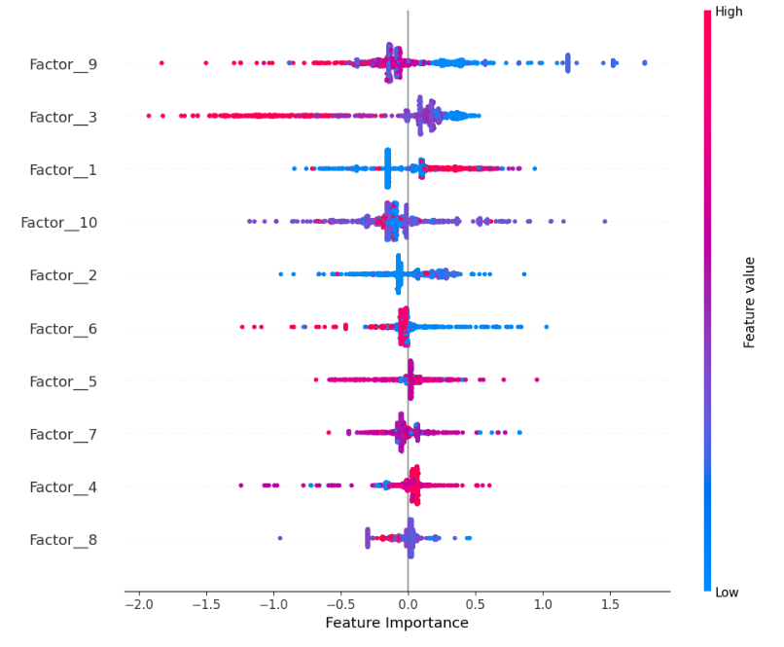
Shapley Analysis – Feature Importance (Target = Composite Work Location Preference Score)
Shapley Values for Each Factor
Direction of Impact

Slide 31
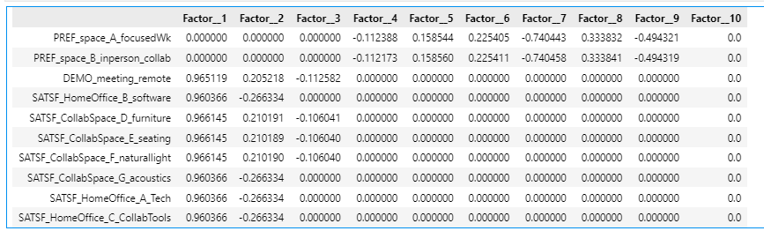
Factor Loadings – Factor 9 Major Contributors

Slide 32
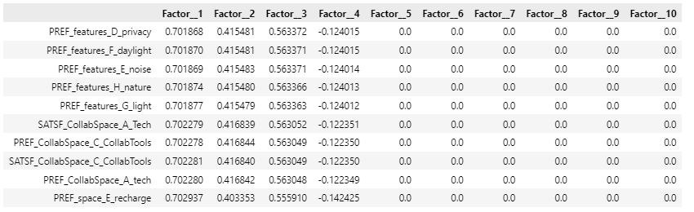
Factor Loadings – Factor 3 Major Contributors

Slide 33
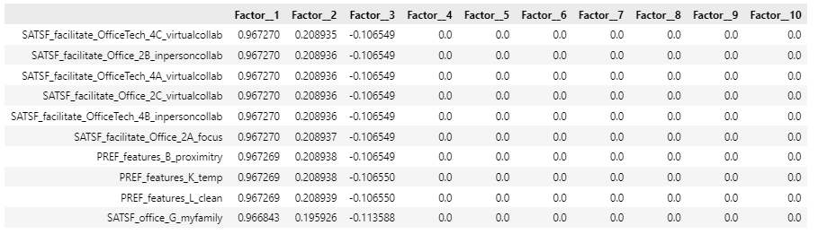
Factor Loadings – Factor 1 Major Contributors

Slide 34
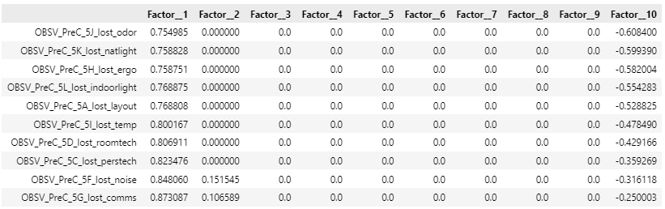
Factor Loadings – Factor 10 Major Contributors

Slide 35
Potential Increase in Productive Work Hours Calculations
 | Office = layout problems | Hybrid = unwanted visitor problems | WFH = noise problem
% Of People Out Of Entire Dataset [1] | 15% | 36% | 49%
% Of Employees who had issues in this cluster [2] | 83.76% | 78.00% | 75.70%
Assumed - Mid Size Organization with 500 employees [3] | 500 | 500 | 500
% of people in assumed organization that fall in this cluster [1]*[3] ---- [4] | 75 | 180 | 245
% of people with layout problem in assumed organization [2]*[4] --- [5] | 62.82 | 140.4 | 185.465
Mins lost Avg In a Week due to distraction [6] | 53.3 | 136.8 | 104
Mins lost total in assumed organization [5]*[6] --- [7] | 3348.306 | 19206.72 | 19288.36
Hours lost total per week [7]/60 --- [8] | 55.81 | 320.11 | 321.47
Assumed decrease in productive hours lost by implementing Workforce Copilot [9] | 0.6 | 0.6 | 0.6
Time Saved in Hrs Per Week [8]*[9] --- [10] | 33.48 | 192.07 | 192.88
Total Hours Saved In Organization SUM[10]-- [11] | 418.43 Hrs
 |  | Hybrid | Office | WFH
Group-1: Collaboration Satisfaction* > Avg(Collaboration Satisfaction) --- [1] | Avg. Collab_Satisfaction Rating --- 1.i | 4.3 | 4.3 | 4.3
 | Count of Collab_Satsf_Rule Rating --- 1.ii | 272 | 123 | 420
Group-2: Collaboration Satisfaction* < Avg(Collaboration Satisfaction) ---[2] | Avg. Collab_Satisfaction Rating -- 2.i | 2.9 | 2.8 | 2.5
 | Count of Collab_Satsf_Rule Rating --- 2.ii | 89 | 31 | 71
Employee Base Who have below avg satsf SUM(2.ii)/(Sum(2.ii) + Sum(1.ii))*100 --- [3] |  | 19%
Potential Bump In Satisfaction Points by Implementing Recommendations in this cluster [1.i] - [2.i] --- [4] |  | 1.4 | 1.5 | 1.8
Potential Bump In Satisfaction % by Implementing Recommendations [4]/[2.i] --- [5] |  | 48% | 54% | 72%
Potential Bump In Organization Satisfaction Points by Implementing Recommendations Overall Avg[4] --- [6] |  | 1.57
Potential Bump In Organization Satisfaction % by Implementing Recommendations Overall Avg[5]--- [7] |  | 57.95%
*Collaboration Satisfaction = ([SATSF facilitate Office 2B inpersoncollab] + [SATSF facilitate Office 2A focus] + [SATSF facilitate Office 2C virtualcollab])/3
Notes:
Forbes suggests WFH becoming the norm, focusing on minimizing distractions.
Techniques emphasized:
Controlling workflow.
Reducing multitasking.
Eliminating distractions.

Slide 36
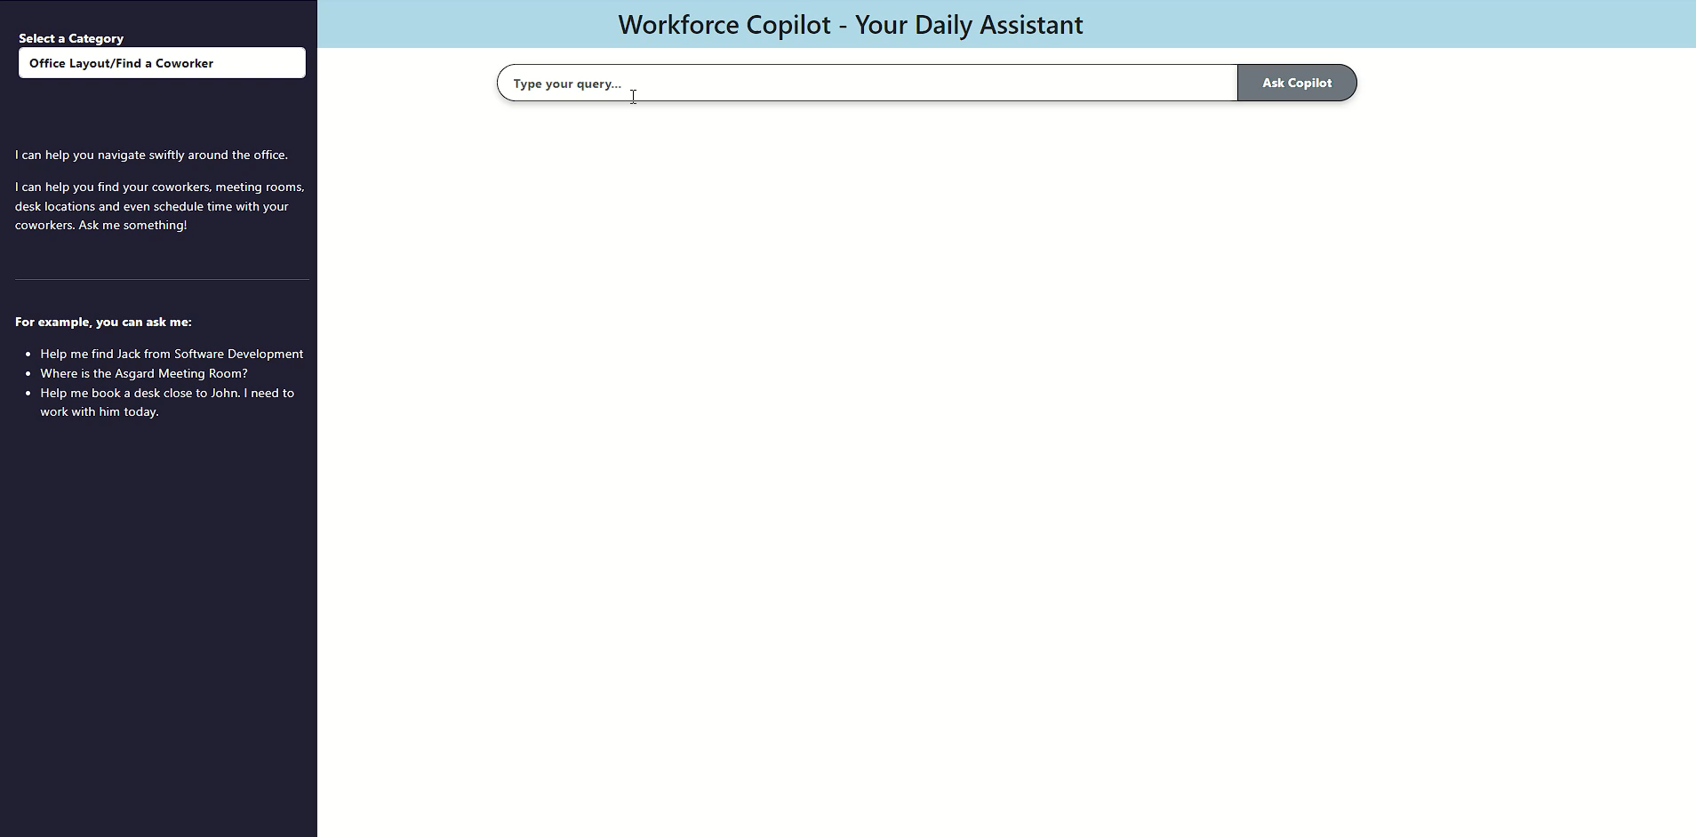
Copilot Demo – Video Walkthrough

Slide 37
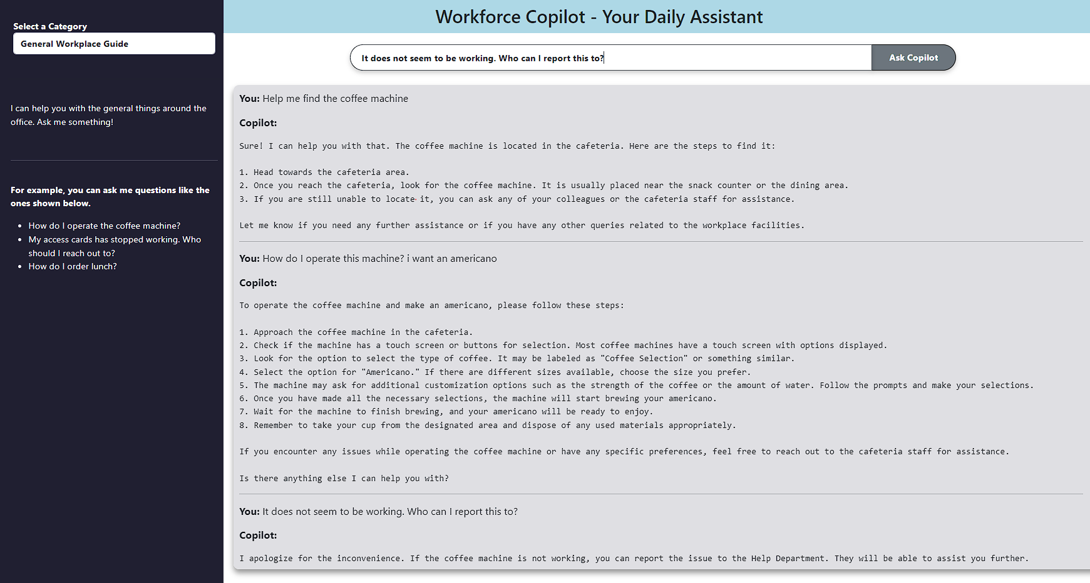
Copilot Demo – General Help Around The Office

Slide 38
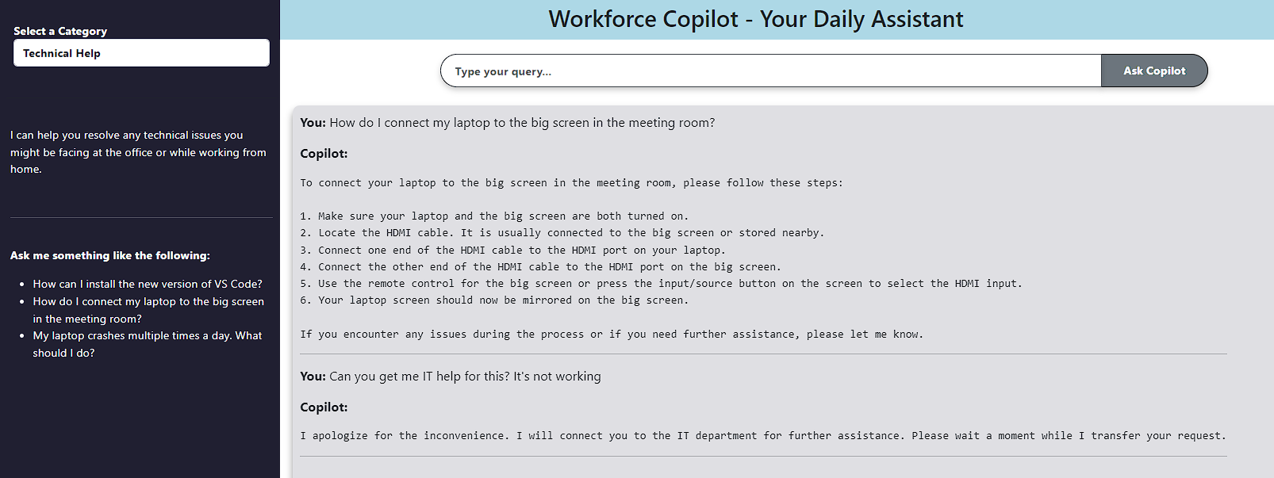
Copilot Demo – IT Support

Slide 39
OFFICE LAYOUT ISSUES +VISTOR DISTURB+ EASE OF COLLABORATION
Distraction Metrics | Employees with Sats < 3 (avg time lost) | Employees with Sats >= 3 | Percent difference
OBSV_PreC_5A_lost_layout | 53 min | 41 min | -24%
OBSV_PreC_5B_lost_looking | 81 min | 42 min | -49%
OBSV_PreC_5D_lost_roomtech | 33 min | 27 min | -18%
OBSV_PreC_5E_lost_visitors | 203 min | 109 min | -46%
Total | 307 min | 190 min | -38%

Slide 40
NOISE AND FOCUS
Moving from Dissatisfied to Satisfied
Expected Distraction Reduction
Distraction Metrics | Employees with Sats < 2.5 (avg time lost) | Employees with Sats >= 2.5 | Percent difference
OBSV_PreC_5F_lost_noise | 142 min | 49 min | -65%

